Slide 1
Capstone Project 1 – team mavericks
Tech-Lead: Yash Shah 100768592 Team Member: Geethu Kannan 100801786 Team Member: Shraddha Khadepatil 100820094 Team Member: Varun Kadian 100820124 Team Member: Yash Halani 100848564

Slide 2
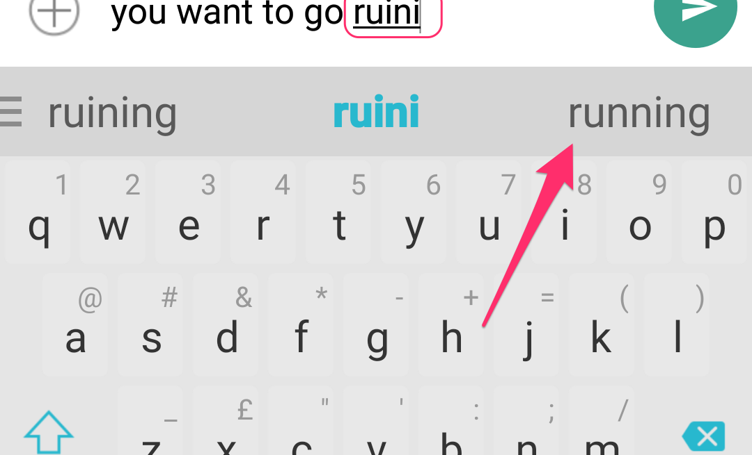
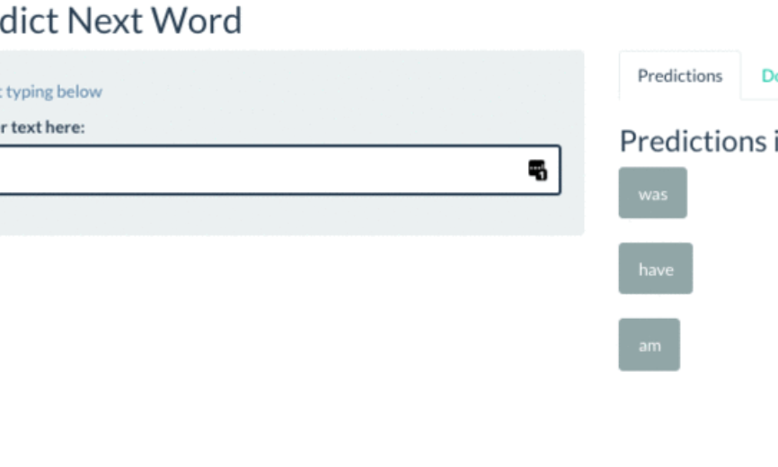
Next Word Predictor The task of predicting what word will come next
Data Collection
Prepare and Pre-process the data
Model the data
Train and Test the model
Verify and Deploy the Model

Slide 3
Technologies to be used
Model Development: Python
Web Development: Flask
Application Deployment: Heroku

